Slide 1


FYP
IntegraGuard Survellience System
Zainab Khalid(2326-2021)
Nida Aamir(2458-2021)
Supervisor: Mr. Afzal Hussain
Co-Supervisor: Mr. Mustafa Ali
Department of Computing, FEST
Hamdard University

Slide 2
Summary
Introduction
Why we choose this project?
Problem Statement
Objective
Project Scope
Flowchart
Dataset
Result
Application UI
Future Work
Conclusion

Slide 3
Introduction
Integra Guard is a real-time ATM surveillance solution designed to detect visible weapons such as knives and Guns using AI.
The system leverages YOLOv8 for high-accuracy object detection and uses a web-based dashboard for monitoring.
Instant alerts are sent to security personnel via Firebase notifications and email, ensuring timely responses.
The system reduces human dependency and boosts the overall security of ATM

Slide 4
Why did we choose this project?
IntegraGuard Surveillance System addresses the rising security concerns in ATM spaces.
It integrates modern AI with traditional surveillance to detect weapons and alert operators instantly.
With a user-friendly dashboard and automated notifications, it fills the critical gap in ATM safety.
Its objective is to redefine how ATMs are protected by ensuring proactive and intelligent threat management.

Slide 5
Problem Statement
ATM security systems mostly rely on outdated surveillance methods that are not actively monitored.
Due to manual monitoring and human error, real threats often go unnoticed or receive delayed responses.
Surveillance personnel are overwhelmed with hours of CCTV footage, making it hard to respond in real-time.
An AI-driven system is urgently needed to detect visible threats such as weapons in live video streams.
Integra Guard addresses this gap by offering automated, intelligent surveillance that enhances ATM safety and enables instant threat response.

Slide 6
Objectives
Develop a real-time threat detection system using AI and deep learning.
Implement YOLOv8 for high-speed weapon detection on video streams.
Create a responsive web-based dashboard to monitor live feeds and threat logs.
Send immediate notifications to authorized personnel through Firebase and email.
Reduce dependency on human monitoring and improve threat response accuracy.

Slide 7
Project Scope
In Scope:
- Detection of visible weapons (knives,Guns) using YOLOv8.
- Real-time monitoring through a React-based dashboard.
- Email and push notifications on threat detection.
- Detection history and reporting through Firebase logging.
Out of Scope:
- Detection of concealed weapons.
- Advanced analytics like emotion or crowd behavior detection.
- Audio-based anomaly detection or gunshot recognition.

Slide 8
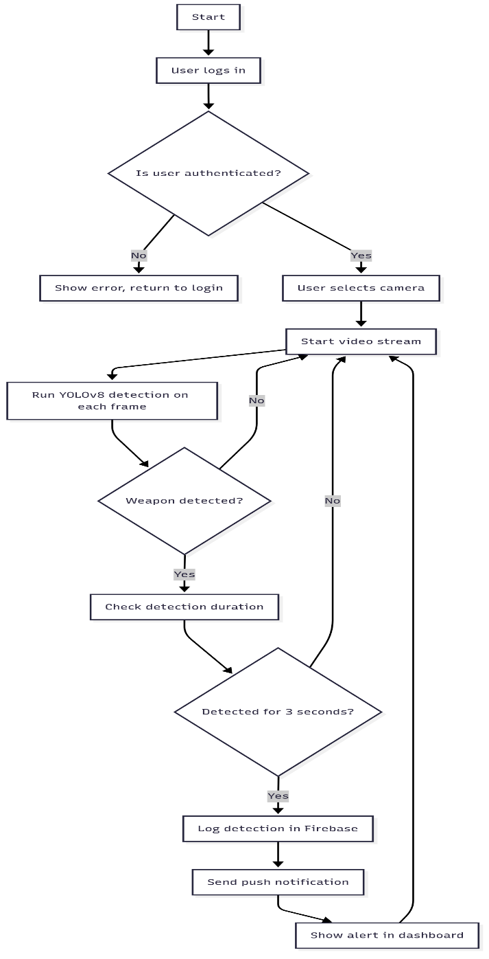
Flowchart

Slide 9
Dataset
Dataset Used: Weapon Detection Dataset (Kaggle)
The Weapon Detection dataset is a publicly available image dataset curated for training and evaluating models in weapon recognition tasks using computer vision. Total Classes: Multiple weapon types (e.g., knife, gun) Training Images: 43,000 Testing Images: 21,500 Annotations: Provided for both training and testing sets (bounding boxes and labels) Use Case: Real-time object detection for surveillance and safety systems

Slide 10
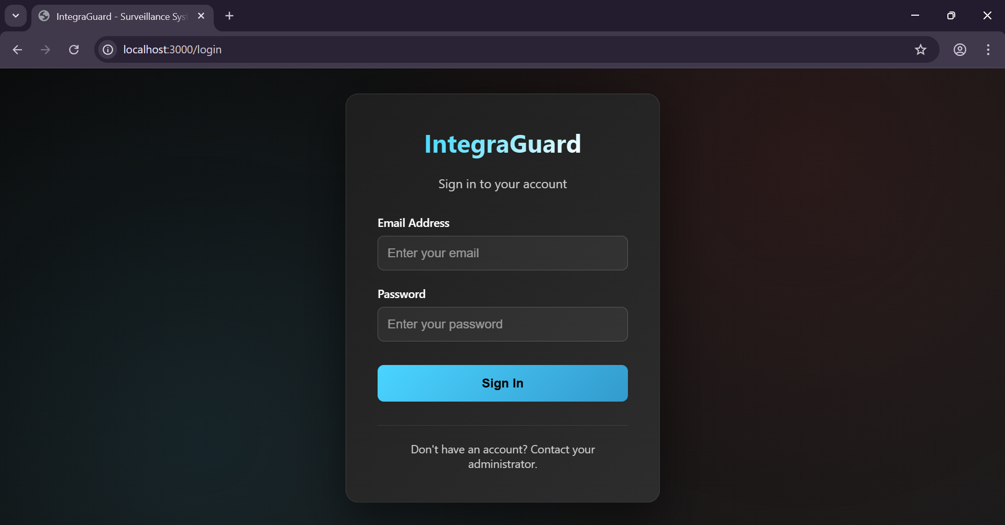
Application UI

Slide 11
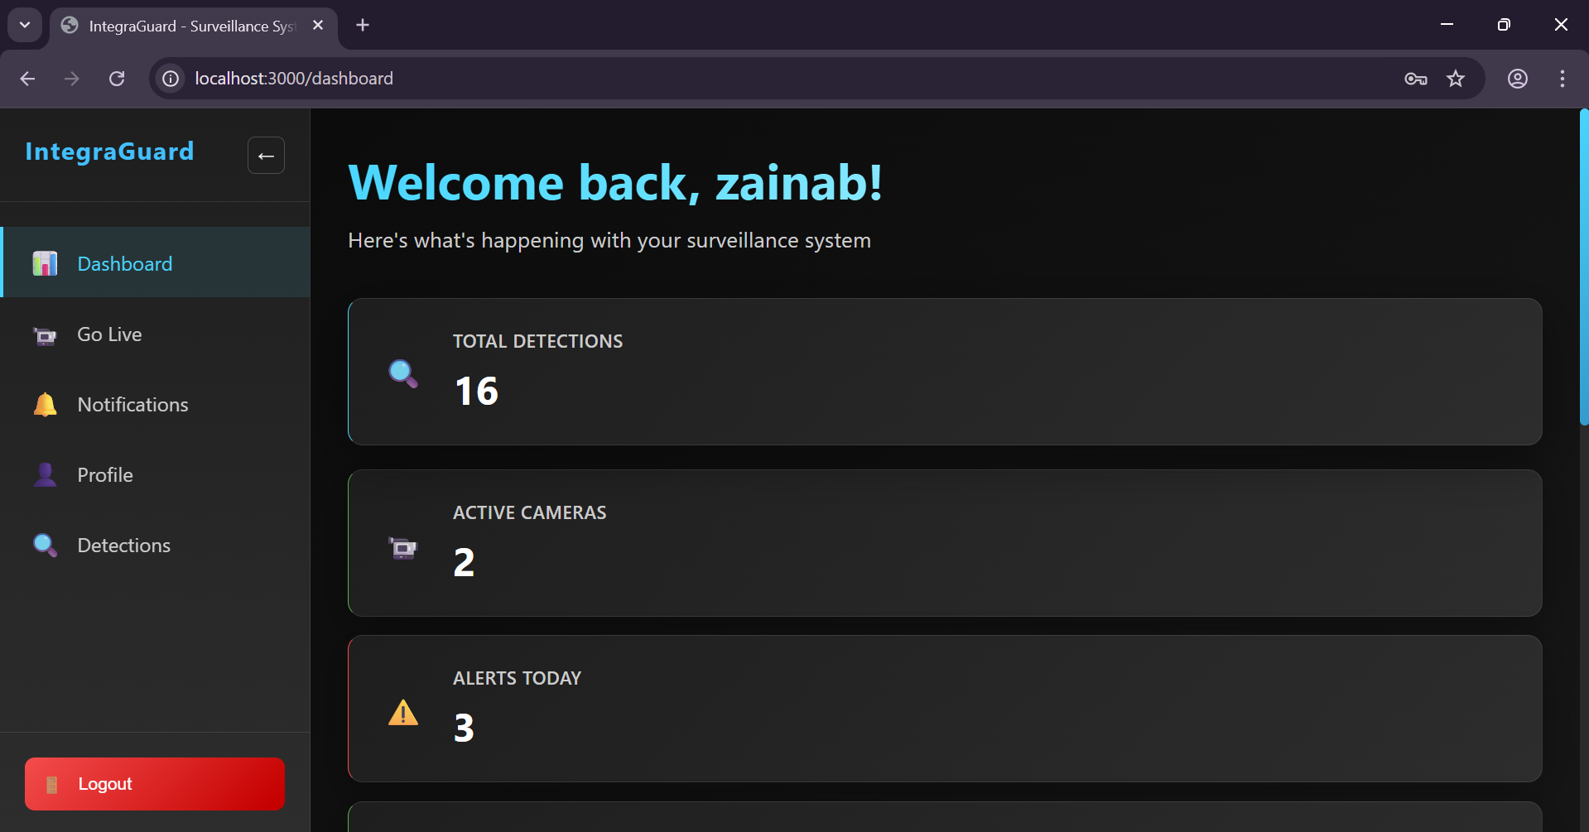
Application UI

Slide 12
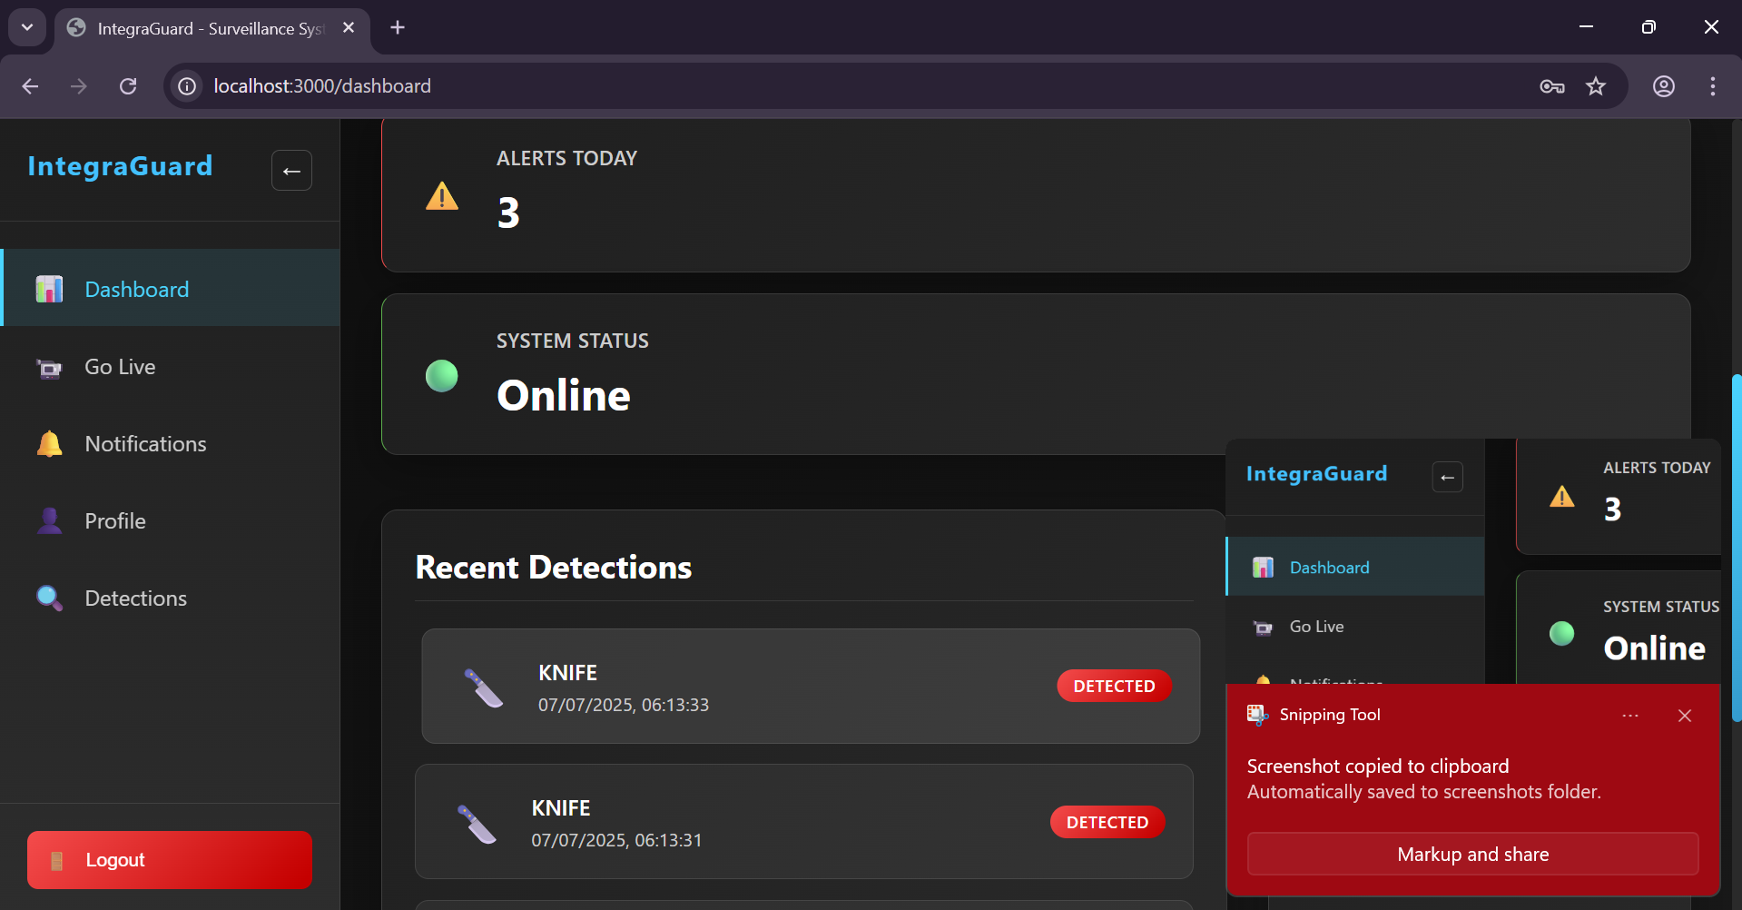
Application UI

Slide 13
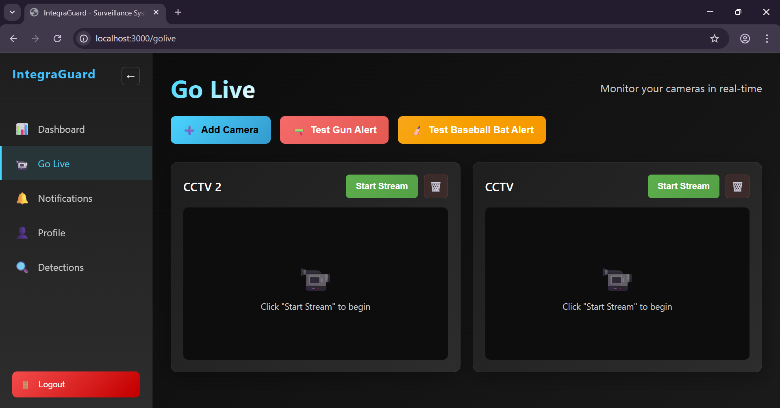
Application UI

Slide 14
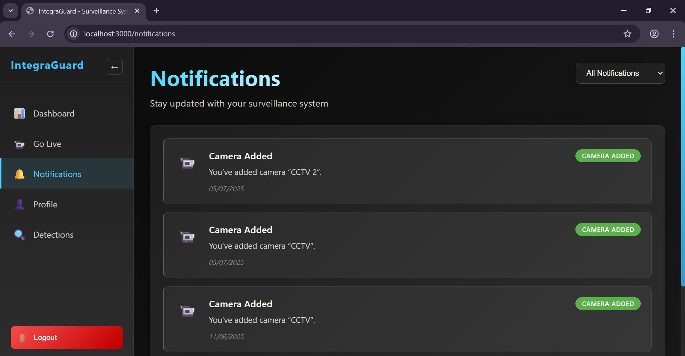
Application UI

Slide 15
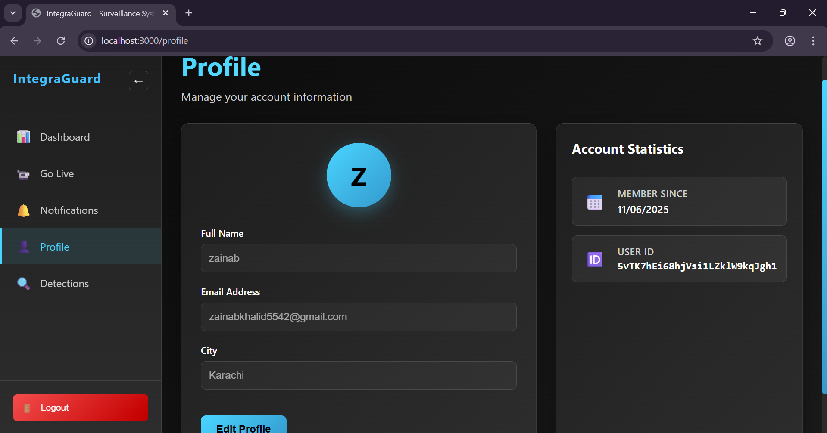
Application UI

Slide 16
Future Work
Train a model for detecting more weapon types including concealed firearms.
Integrate behavioral analytics such as loitering or suspicious movement.
Add support for multi-camera centralized monitoring systems.
Incorporate legal integrations with law enforcement or emergency response teams.

Slide 17
Conclusion
IntegraGuard is a modern solution to outdated ATM surveillance challenges.
It delivers real-time weapon detection with minimal latency and high precision.
The system simplifies operations, improves response time, and reduces crime risk.
Scalable, accessible, and adaptable for wider use in banks, schools, and offices.

Slide 18
References
Ahmed S. et al., Appl. Sci., 2022 – "Development and optimization of deep learning models for weapon detection in surveillance videos" https://doi.org/10.3390/app12125772
Abins A.A. et al., IEEE ICETITE, 2024 – "Weapon Recognition in CCTV Videos: Deep Learning Solutions for Rapid Threat Identification" https://doi.org/10.1109/ic-etite58242.2024.10493569
Wang G. et al., Digit. Signal Process., 2023 – "Fighting against terrorism: A real-time CCTV autonomous weapons detection based on improved YOLO v4" https://doi.org/10.1016/j.dsp.2022.103790
Salazar González J.L. et al., Neural Netw., 2020 – "Real-time gun detection in CCTV: An open problem" https://doi.org/10.1016/j.neunet.2020.09.013
Bamnolkar A.K. et al., IEEE ICSC, 2025 – "Cutting Edge Weapon Detection in Real-Time CCTV Videos" https://doi.org/10.1109/icsc64553.2025.10968883
Keerthana S.M. et al., IEEE ICICET, 2024 – "Weapon Detection For Security Using The Yolo Algorithm With Email Alert Notification" https://doi.org/10.1109/icicet59348.2024.10616365
Kumar J.A. et al., IEEE ICICNIS, 2024 – "Weapon Detection Identification and Classification for DCNN and YOLO-V5 Techniques" https://doi.org/10.1109/icicnis64247.2024.10823365

Slide 19
ThankYou!

